Slide 1
Presentation For Awareness From Phishing Attack
Presented by: Mustasam Ateeq
Presented To : CodeAlpha
Task no: 2

Slide 2
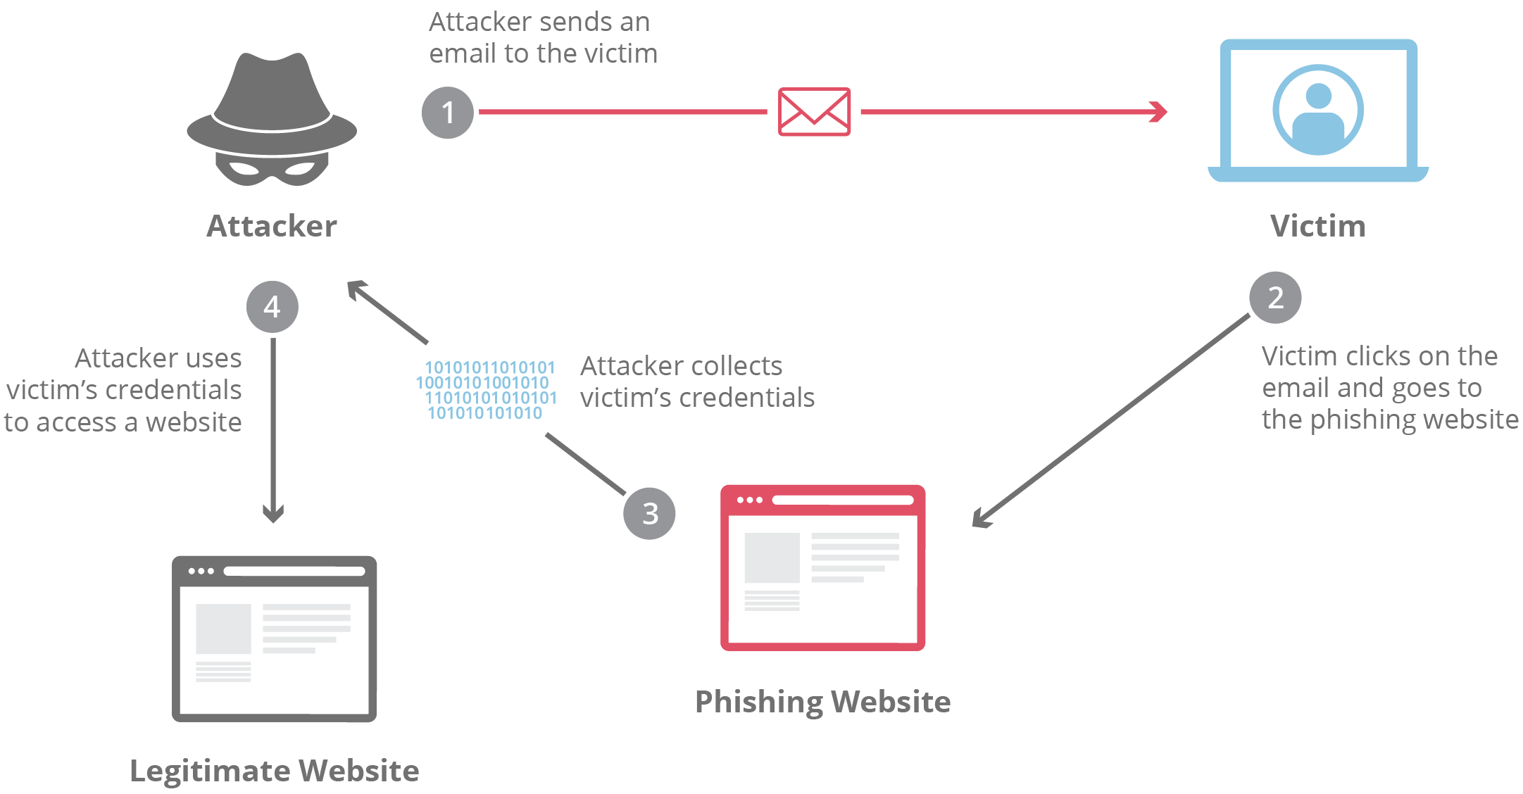
What is Phishing Attack?
Definition of Phishing Attack:
Phishing attack is lunched to stole confidential information of an individual or corporate company. These information include emails, usernames, password, confidential documents, credit card, bank account information, & other important information.
Purpose of Phishing attack:
The main purpose of phishing attack is to steal confidential information about a well reputed corporate company or individual and sell their information in black market or on dark web. Sometimes your opponents lunch these attack to harm you and defeat corporate company in making well reputation in corporate sector.

Slide 3

How Phishing Attack Works
The easiest way to commit a robbery is probably to convince the victims they aren’t being robbed at all. That’s the phishing scammer’s basic model.
Phishing attacks begin with an email, phone call, SMS message, social media post, or the like that seems to be from a reputable source. From here, the attacker may have all sorts of end goals, such as tricking the victim into offering up account information, making a PayPal transfer, downloading disguised malware, and so on.
Let’s look at a common example. An attacker gets ahold of a victim’s email address or phone number. Then, the victim gets an email or text message from what appears to be their bank. The phishing message mentions an expiring special offer, suspected identity theft, or similar, and asks the victim to log in to their bank account. It links to a mock login webpage, and the victim unwittingly gives the attacker their login credentials.
The attack in this example, like most phishing attacks, carefully creates a sense of urgency that fools the victim into lowering their guard instead of taking time to consider whether the message is suspicious. That may be more easily said than done, however, as there are quite a few tricks in the attacker’s playbook.

Slide 4
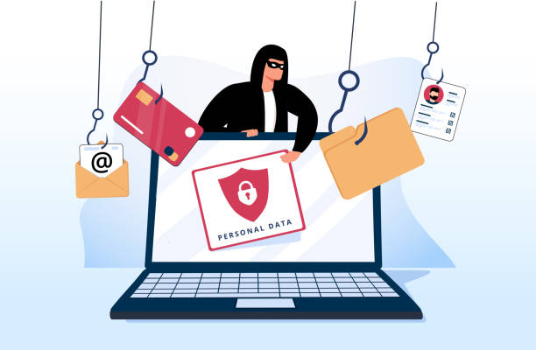
Types of Phishing Attack
Attackers have invented a wide variety of phishing techniques to exploit different technologies, trends, industries, and users. Here’s a glance at some common types:
Email phishing:
Smishing/SMS phishing:
Vishing/Voice phishing:
Angler phishing:
Pop-up phishing:
Spear phishing:
Whaling attacks:
Clone phishing:
Evil twin phishing:
Pharming:

Slide 5

Example from real worlds attack
AOHell, the first recorded Example:
Back in early 1994, a malicious program called AOHell was developed by a Pennsylvania teenager and was intended to crack America Online (AOL) Account.
The Nordea Bank Incident:
1n 2007, Swedish Bank Nordea lost over 7 million kronor when phishers managed to send fraudulent emails out to bank customers, lurning them to install the haxdoor Troojan
Operation phishing phry:
2009 saw one of FBI’s biggest cybersecurity busts ever 1.5 million dollar was stolen via bank frauds by various cyber thevies located in United States and Egypt.

Slide 6
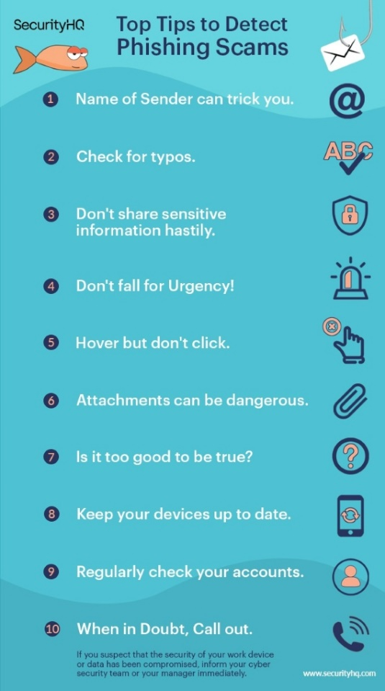
Steps to identify Phishing attack
Check the sender name.
Check for Typos.
Don’t share sensitive information hastily.
Don’t fall for Urgency.
Hover but don’t click .
Attachment can be dangerous .
Is it to good to be true.
Keep your devices up to date.
Regularly check your Accounts
When in doubt, Call out

Slide 7
How to prevent from phishing attacks
As with any kind of unsolicited email (often referred to as ‘spam’), phishing emails cannot be completely eliminated by a security tool or filtering service. However, there are several actions users can take to diminish the chances of a successful attack:
Evaluate emails for suspicious elements. Email headers may reveal deceptively-worded sender names or email addresses, while the body may include attachments and links that camouflage malicious code. Users should err on the side of caution when opening a message from an unfamiliar sender.
Do not share personal information. Even when communicating with a trusted individual, personal information — e.g. Social Security numbers, bank information, passwords, etc. — should never be exchanged in the body of an email.
Block spam. Most email clients come with built-in spam filters, but third-party filtering services can give users more granular control over their email. Other recommendations for avoiding email spam include unsubscribing from mailing lists, refusing to open spam emails, and keeping email addresses private (i.e. not listing them on an organization’s external-facing website).
Use email security protocols. Email authentication methods like SPF, DKIM, and DMARC records help verify the source of an email. Domain owners can configure these records to make it difficult for attackers to impersonate their domains in a domain spoofing attack.
Run a browser isolation service. Browser isolation services isolate and execute browser code in the cloud, protecting users from triggering malware attachments and links that may be delivered through a web-based email client.
Filter harmful traffic with a secure web gateway. A secure web gateway (SWG) inspects data and network traffic for known malware, then blocks incoming requests according to predetermined security policies. It can also be configured to prevent users from downloading files (like those that may be attached to a phishing email) or sharing sensitive data.
Verify the message with the sender. If an email message still seems suspicious, it may be necessary to independently confirm the message was sent by a legitimate individual or organization. There are several verification methods that can be used to do this, like a phone call or text message. When in doubt, ask the sender if there is a more secure way to transmit any sensitive information they may have requested.

Slide 8
What to do if you fall Victim
Figure out what happened.
Report the attack.
Contact the implicated Company.
Disconnect the Device.
Update any Potentially compromised passwords
Run a malware scan.
Watch out for identity theft

Slide 9
Resources of information
Cloudflare
link : https://www.cloudflare.com/learning/email-security/how-to-prevent-phishing/
Town of HEMPSTEAD
link : https://www.hempsteadny.gov/635/Famous-Phishing-Incidents-from-History
Security HQ:
link : https://www.securityhq.com/blog/top-tips-to-detect-phishing-scams/

Slide 10


